Slide 1

Topic: Sales Revenue Tracking System
Comprehensive Analysis of Revenue Streams, Regional Trends, and Team Productivity metrics for the current fiscal period.
Team Member : Mukesh Mishra
Saubhagya Munsi

Slide 2

DATA ANALYSIS
& CHALLENGES
The initial dataset was characterized by significant operational noise, requiring a multi-stage audit before visualization could occur.
Incomplete Records: Multiple Order IDs with missing Customer names and Salesperson IDs.
Data Type Inconsistency: Financial columns contained mixed formats {currency strings vs numeric values).
Regional Misalignment: Redundant entries for East and West regions due to spelling variations.

Slide 3
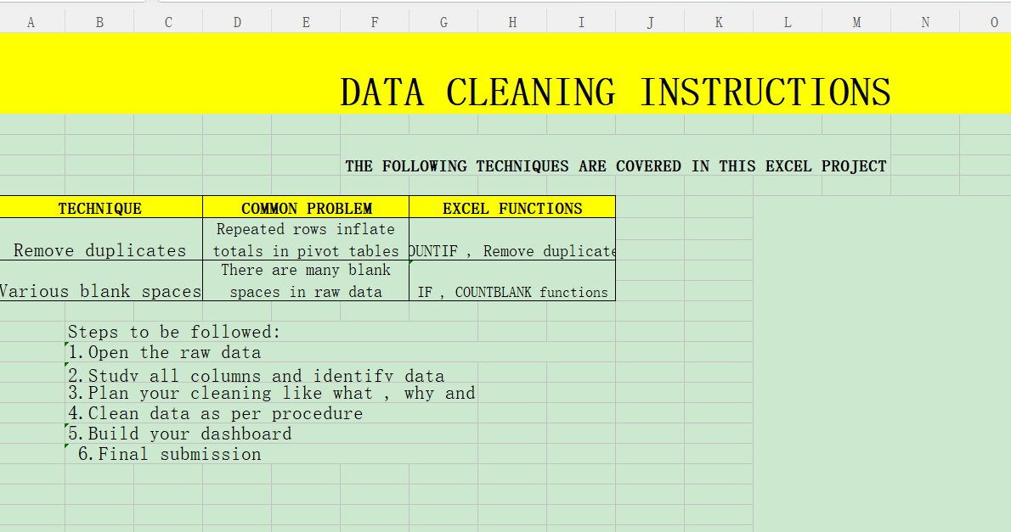

Slide 4
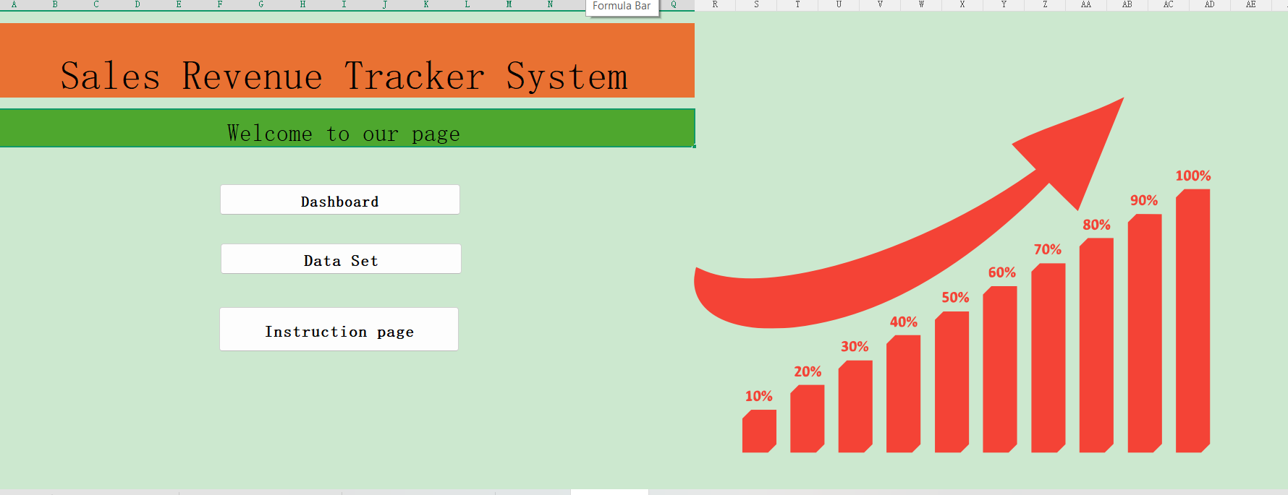

Slide 5
EXECUTIVE SUMMARY
$98,781
27% East/West
Strategic dominance in East and West regions, contributing to over half of the total revenue share.
Top Tier: Rahul Das
Leading the salesperson leaderboard with significant deal closures in the Electronics and Furniture segments.
Total Revenue generated across all categories. High stability observed in baseline sales with consistent month-on-month growth.
Strategic Insight: The data lifecycle transition from fragmented raw sources to a cleaned, actionable dashboard has revealed
high-margin opportunities in Stationery and Electronics previously obscured by data noise.

Slide 6
DATA CLEANING & TRANSFORMATION
Normalization Protocol
To ensure dashboard accuracy, a strict data cleaning protocol was implemented, resulting in a 100% reduction in "Unknown User" artifacts.
Step 1
Step 2
Removal of empty rows/columns and duplicate Order IDs.
Standardization of product categories and regional identifiers.
Step 3
Step 4
Calculated field generation for Revenue, Cost, and Profit margins.
Validation of target vs. actual achievement ratios.

Slide 7

THE CENTRALIZED DASHBOARD
Our interactive hub serves as the primary intelligence center for management, allowing for granular slicer-based filtering across Regions and Product Categories.
1a10
---
2000s
----
2009
00
Real-time Tracking: Instant visibility into the $98.7K
revenue milestone.
Regional Slicers: Dynamic updates for East, West, North, and South segments.
Category Drill-down: Analysis across Electronics,
Furniture, and Stationery.
0

Slide 8





REGIONAL REVENUE DISTRIBUTION
East (27%)
: Highest revenue contributor at -$26.6K
West (27%)
: Equal lead with East, focused on Electronics
North (23%)
: Emerging market with high Furniture demand
98.7K
TOTAL SALES
South (23%)
: Stable performer in Stationery category
Note: Regional parity suggests a balanced national expansion strategy without over-reliance on a single territory.

Slide 9
SALES FORCE PRODUCTIVITY LEADERBOARD
$32K | $25K | $20K | $14K | $7.7K
Rahul Das | Sneha Roy | Amit Paul | Pooja Dey | Others
Top 4 performers account for 92% of the total revenue target achievement.

Slide 10
CATEGORY ANALYSIS
Category | Revenue Share |  | Profitability | Top Salesperson
Electronics | 42% |  | High (22%) | RahulDas
Furniture | 31% |  | Medium (15%) | Sneha Roy
Stationery | 27% |  | High (19%) | Amit Paul
Electronics: Primary volume driver with high unit costs and consistent demand in urban centers.
Stationery: Unexpectedly high margin profile due to low overheads and frequent repeat purchases.

Slide 11
STRATEGIC ROADMAP
Q1: Optimization
Q2:
Expansion
Q3: Diversification
Q4: Automation
Further refine the data pipeline to include real-time CRM integration.
Introduction of "Smart Home" sub-category within the Electronics segment.
Al-driven predictive forecasting to automate inventory replenishment.
Targeted campai•gns for North and South regions to match East/West parity.

Slide 12
Thank You

